Slide 1
Task 2 : Find a vulnerability from website ( http://testasp.vulweb.com )
In this presentation, we find the vulnerability of website with the automated tool Nessus.
We provide
Proper steps
Screenshots
Videos

Slide 2
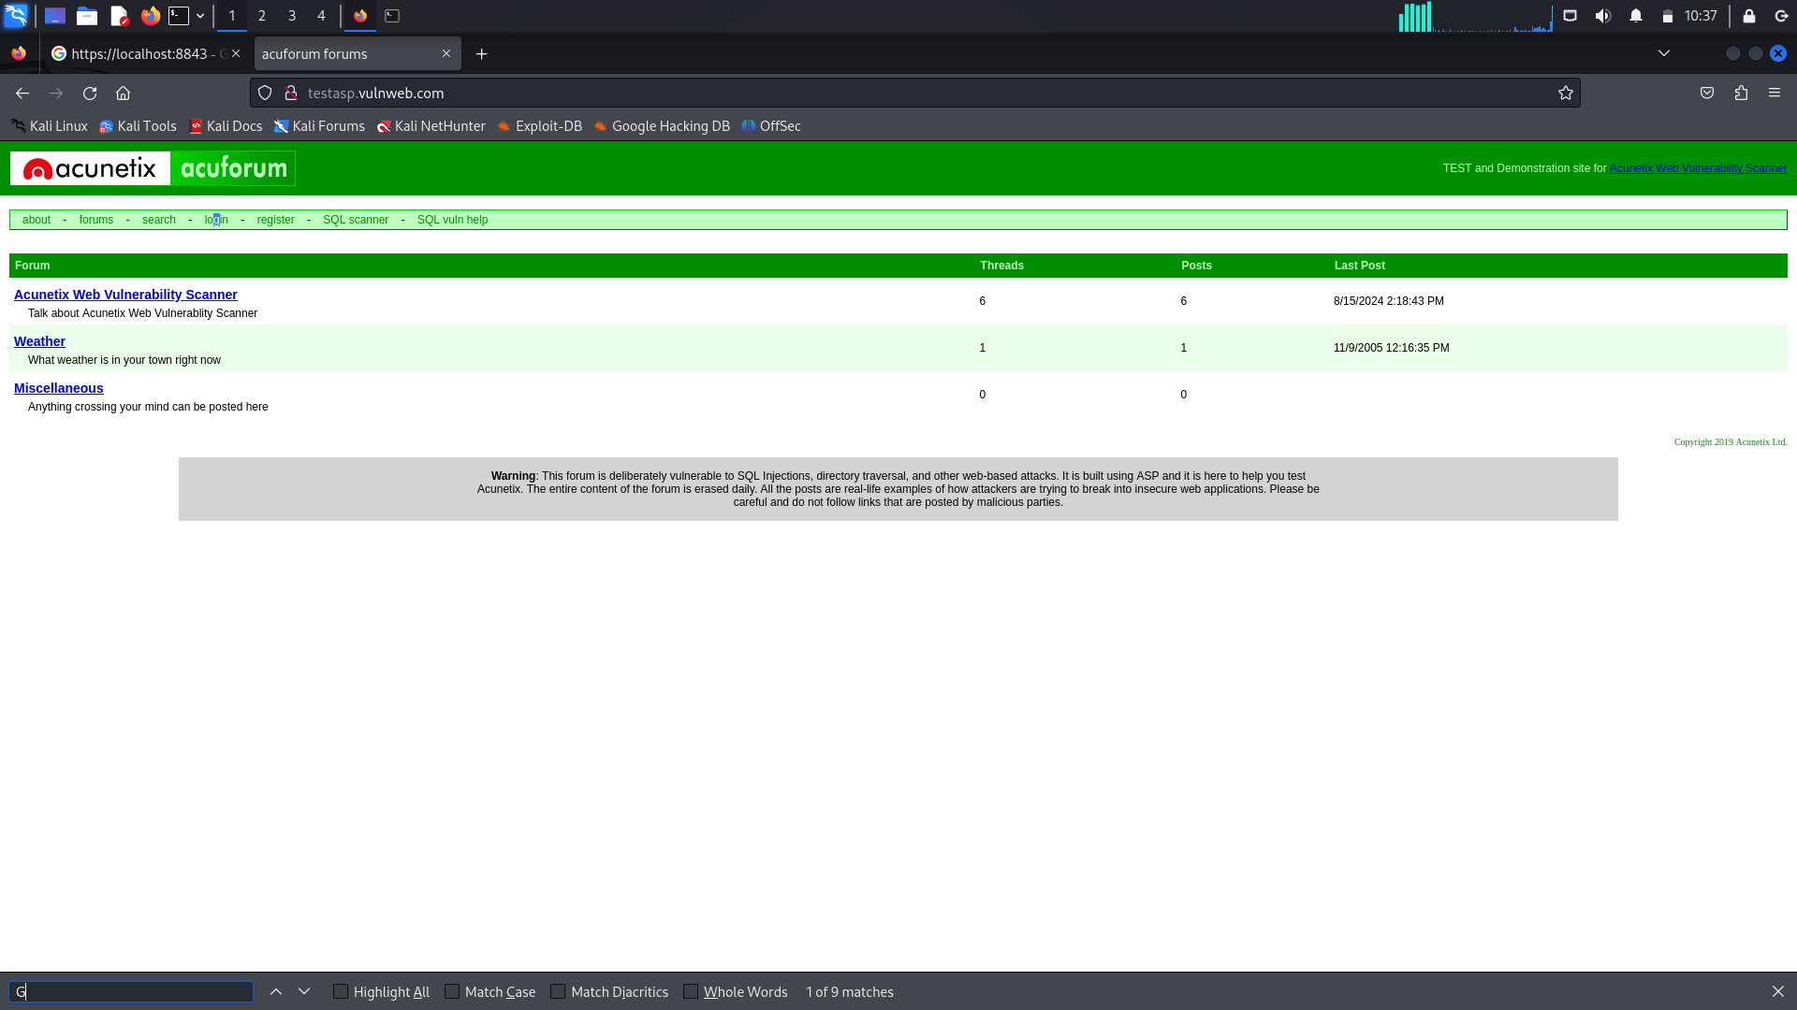
Report
Title: Scanning Vulnerability with Automated Tool.
Domain: vulnweb.com
Sub-domain: testasp.vulnweb.com
Procedure:
Step1: Visit a website and look around What kind of website Is.

Slide 3
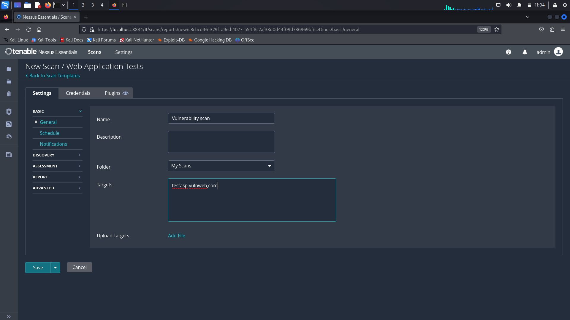
Step2: Install Nessus automated vulnerability scanning tool ( It gives types of vulnerability in Level like critical, high, medium, low )
Step3: Set type of scanning in Nessus.
Step4: Set name: scanning , target: testasp.vulweb.com

Slide 4
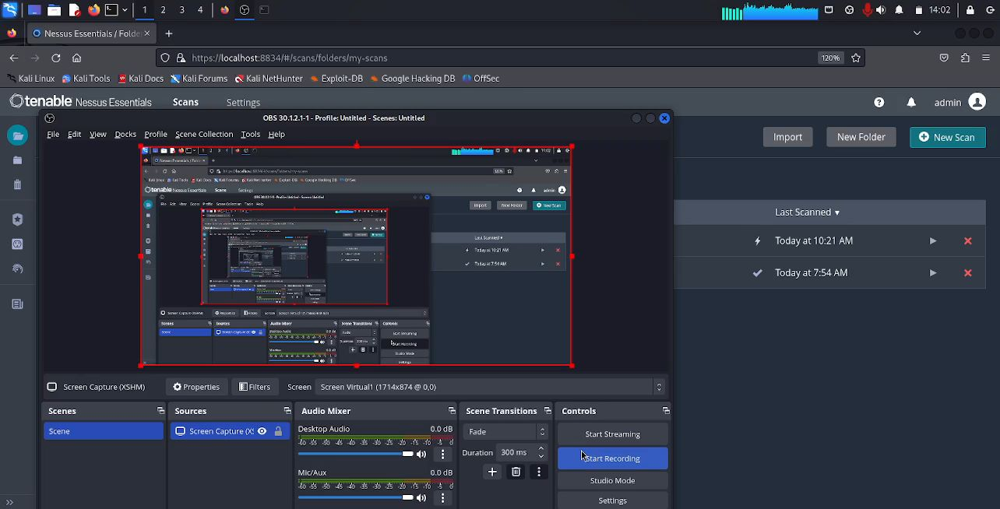
Step5: Start the scanning ( click on save )
Step6: In outcome level of vulnerability with what kind of vulnerability it Is.
Step7: From this we can Exploit the vulnerability.

Slide 6
Step6: In outcome level of vulnerability with what kind of vulnerability it Is.

Slide 7
Step7: From this we can Exploit the vulnerability.

